Slide 1
Kickoff hints
Right click in html page -> inspect element
Use console.log(‘logtext’) for debugging

Slide 2

Reading data from files to variables
.csv(), .tsv(), .json()
Asynchronous function -> returns immediately
Dependent code should be in callback function!
Typically callback function contains all code!

Slide 3
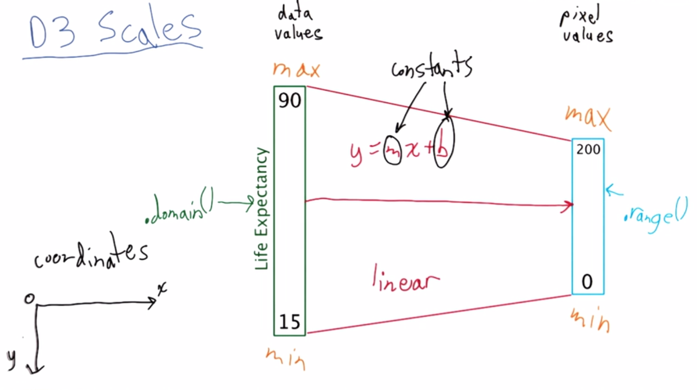
Mapping variables

Slide 4
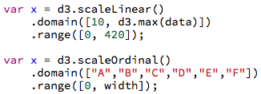
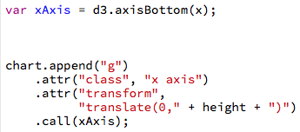
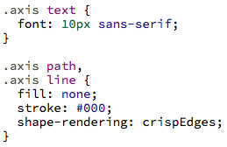
Scales and Axis
Continuous: https://github.com/d3/d3-scale#continuous-scales
Ordinal: https://github.com/d3/d3-scale#ordinal-scales
Categorical => use Ordinal!
Functions: d3.max, d3.min
d3.scaleLinear(), d3.scaleLog()
d3.scaleOrdial()
CSS

Slide 5
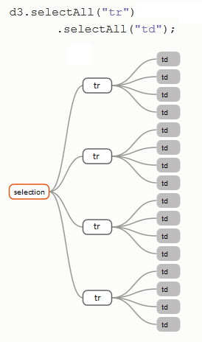
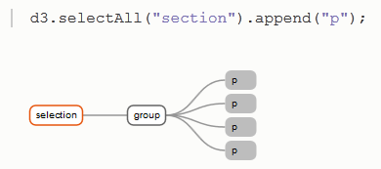
Selecting/Creating elements
Navigating the DOM using d3 CSS selectors! (‘#’ id, ‘.’ class)
.select (returns one el)
D3 has a chainable API

Slide 6
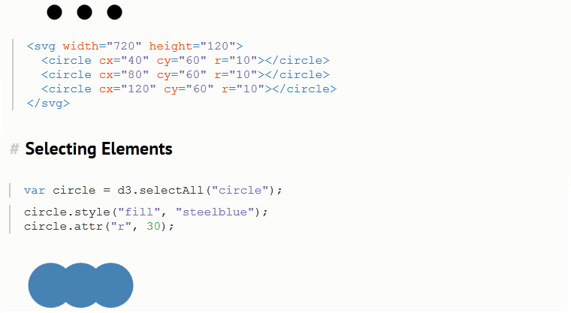
Creating/Modifying selections

Slide 7
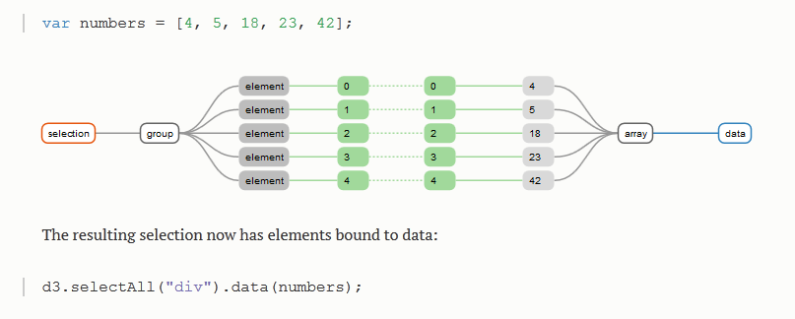
Data Join (1)
data() function adds data to (non)existing
elements in selection
=> div[0].__data__ = 4 (join single element with .datum())
Join by index (join by key is also possible, by specifying second element

Slide 8
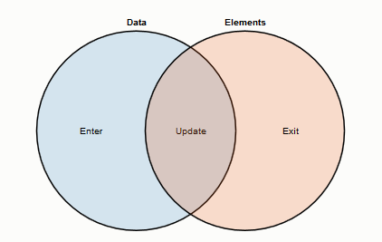
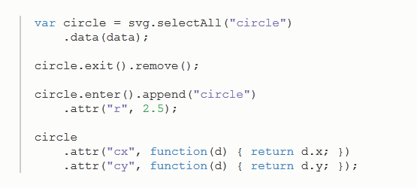
Data Join (2)
data() (updates existing)
enter() (#data > #el)
exit() (#data < #el)
Note: data is inherited
from parent!
var b = d3.select(“body”);
b.datum(42);
b.append(“h1”)
h1 -> also has a data element!

Slide 9
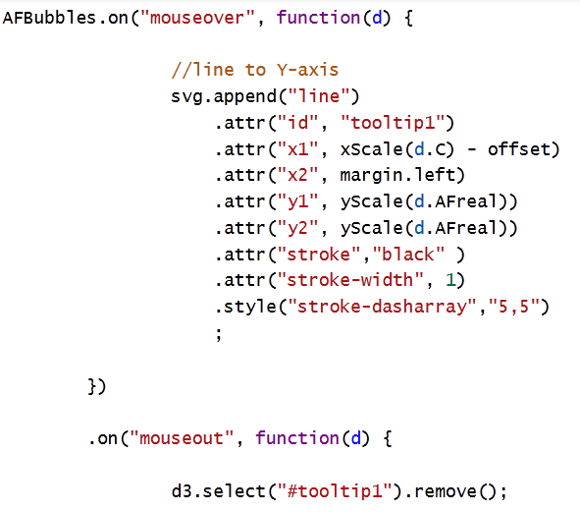
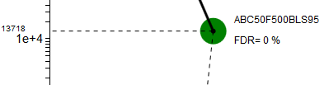
Adding interaction: events

Slide 10
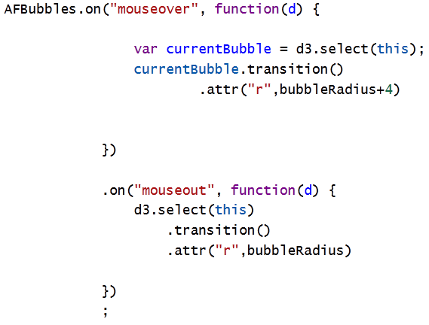
Smooth interpolations: Transitions
.delay(), .duration(), attrTween(), styleTween(),
https://github.com/d3/d3/blob/master/API.md#transitions-d3-transition

Slide 11
Continous animation
buildin setInterval function in javascript:
setInterval(updatefunc(), 1500)
function updatefunc(){
...
}
run updatefunc every 1500 ms

Slide 12
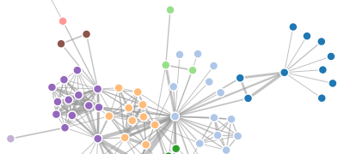
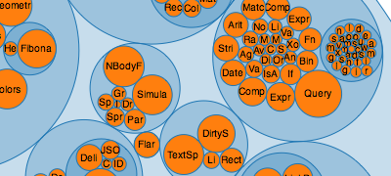
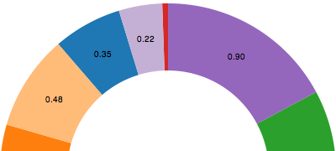
Layouts
“A layout encapsulates a strategy for laying out data elements visually, relative to each other”
https://github.com/d3/d3/blob/master/API.md
d3.layout.force()
d3.layout.pack()
d3.layout.pie()

Slide 13
More tutorials
Scott Murray:
http://alignedleft.com/tutorials
Mike Bostock:
https://github.com/d3/d3/wiki/Tutorials
Three Little Circles
Thinking with Joins
How Selections Work
General Update Pattern I, II, III
Working with Transitions

Slide 14

Getting more help?
www.stackoverflow.com

Slide 15
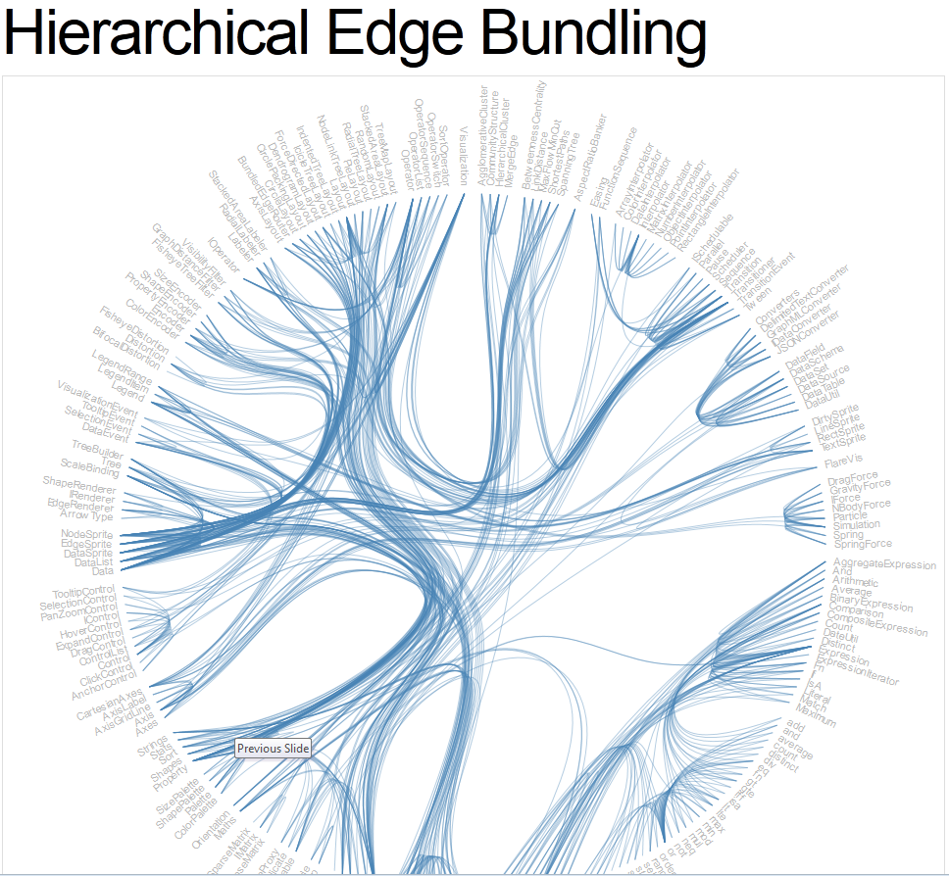
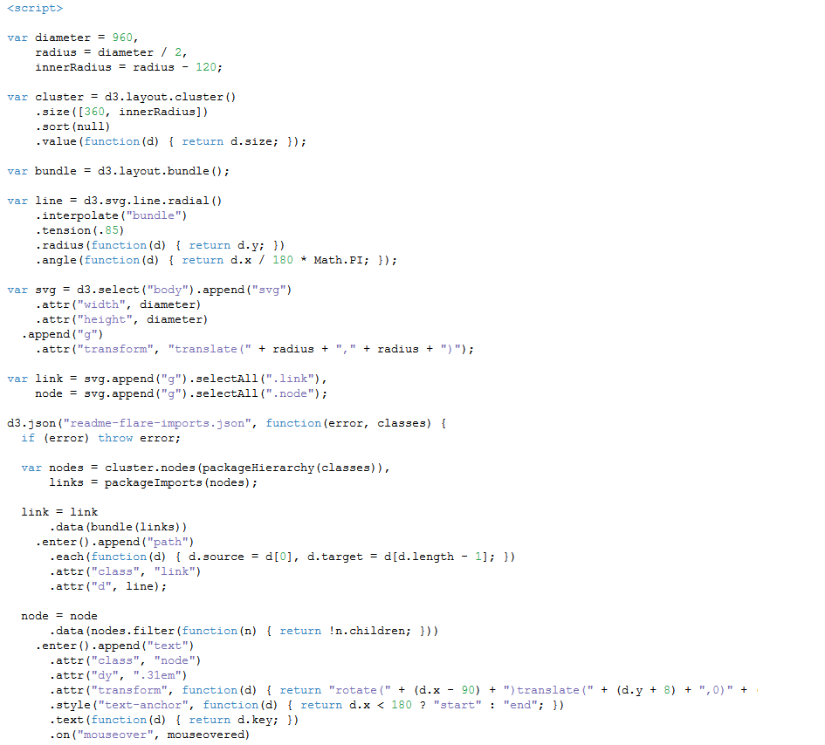
http://bl.ocks.org/mbostock
Notes:
http://bl.ocks.org/mbostock
Mike Bostock is a god! (2)

Slide 16
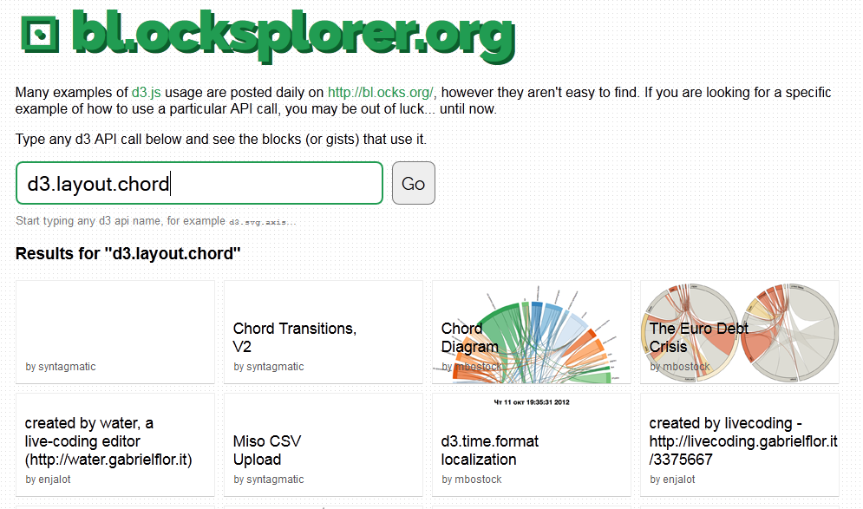
Notes:
Want to see a certain d3 featute used in an example: bl.ocksplorer.org
Mike Bostock is a god! (3)

